Slide 1
Teaching online:
what have we learnt from creating MOOCs (massive open online courses)?
Kate Borthwick,
Director, UoS MOOC Programme
Principal Enterprise Fellow (educational innovation),
K.Borthwick@soton.ac.uk, 28 April 2020

Slide 2
Overview
University of Southampton MOOCs
What we’ve learnt about good practice in:
Online learning design and delivery
Engagement of learners
Tutoring
Questions and comments

Slide 3
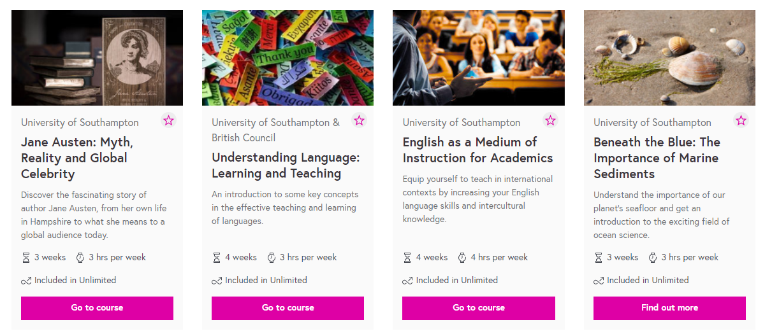
Massive Open Online Courses at UoS

Slide 4
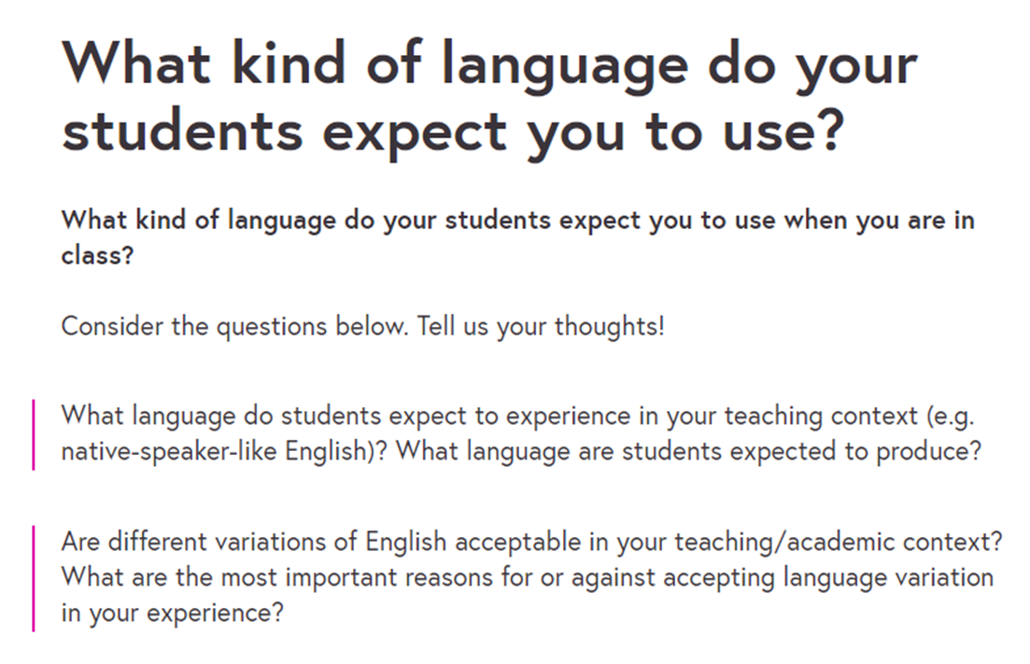
Design and Delivery
Less is more

Slide 5
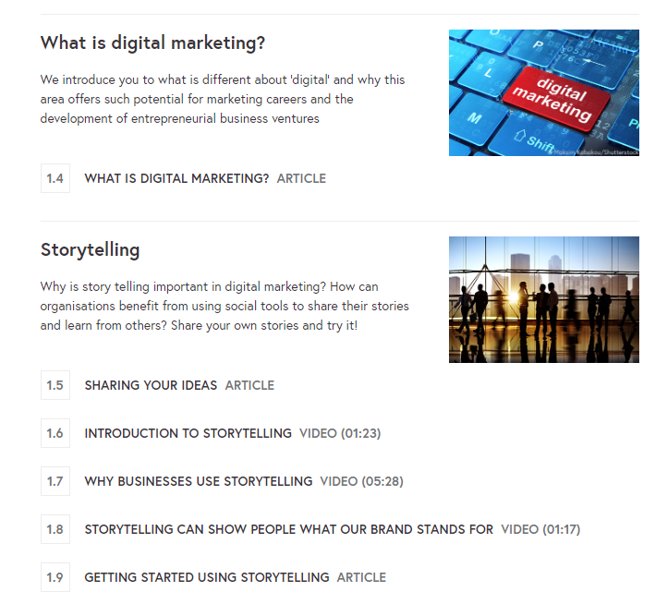
Achievable, ‘bite-sized’ tasks

Slide 6
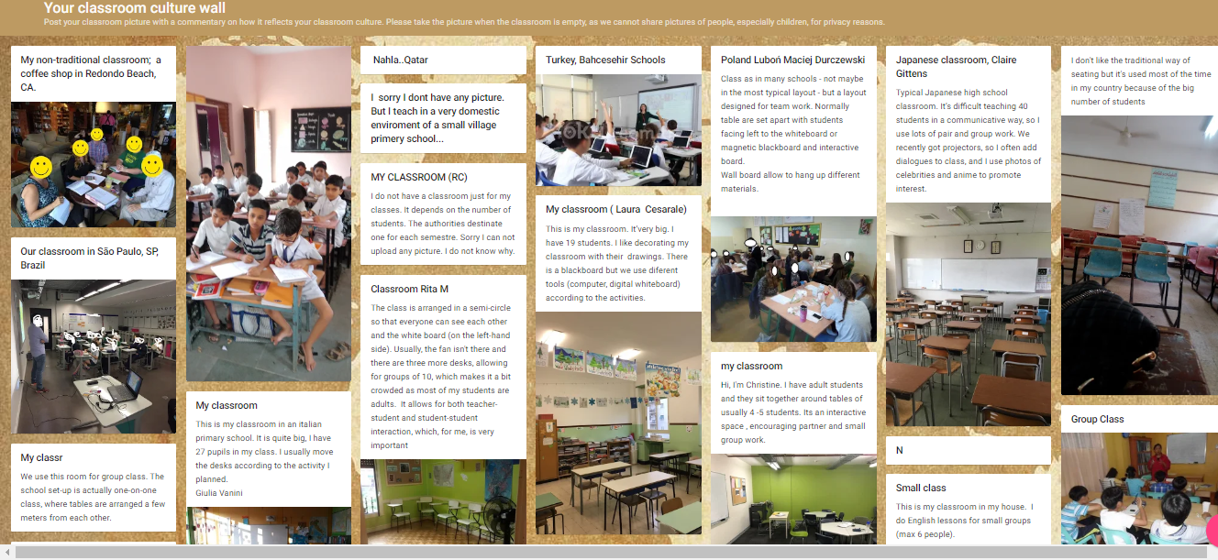
Design and Delivery
Concentrate on your learning outcomes

Slide 7
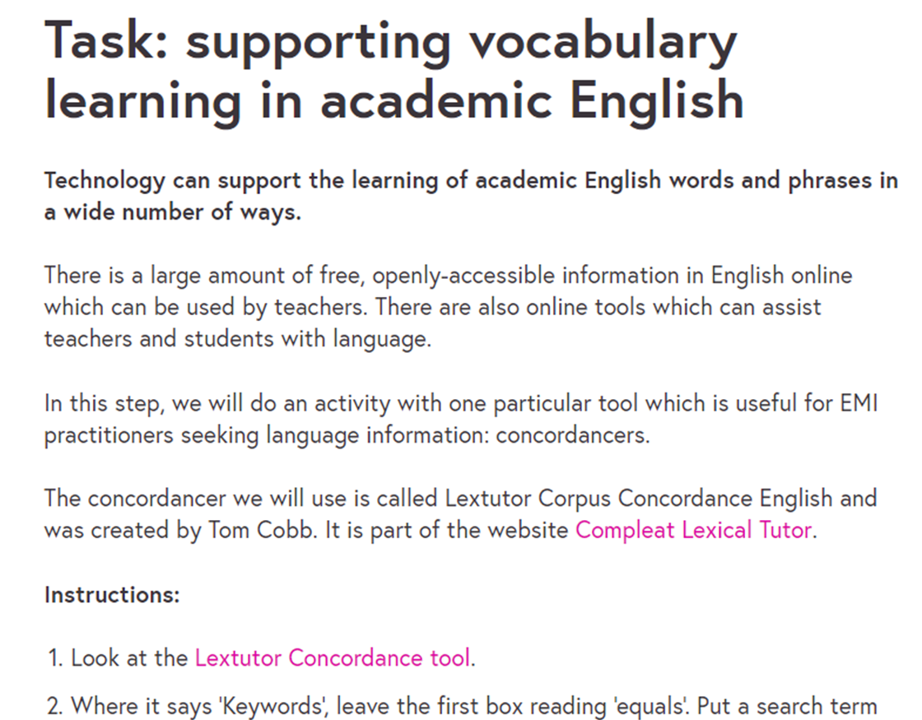
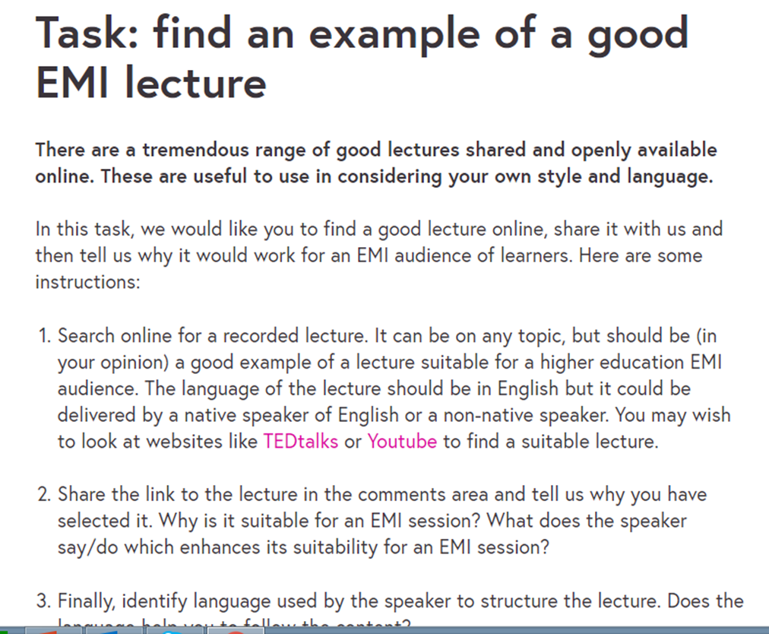
Design and Delivery
Variety in activities

Slide 8
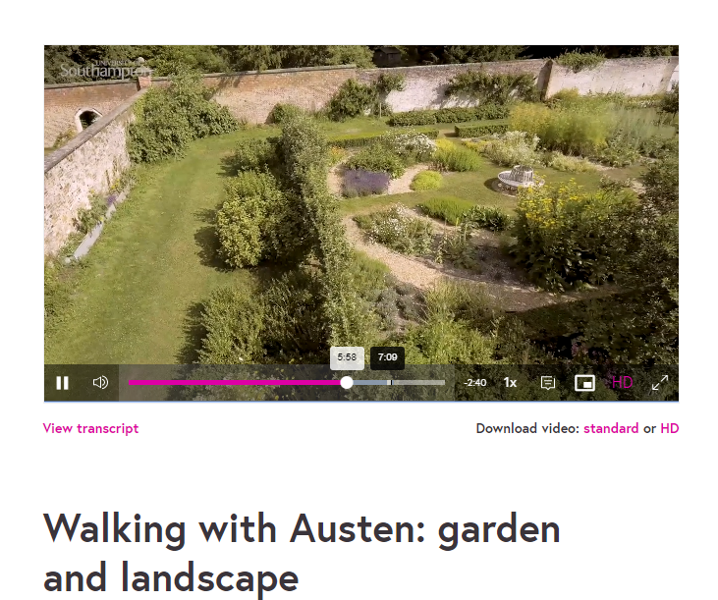
Design and Delivery
Video content should show things
A lot can be prepared in advance and timed to look ‘live’

Slide 9
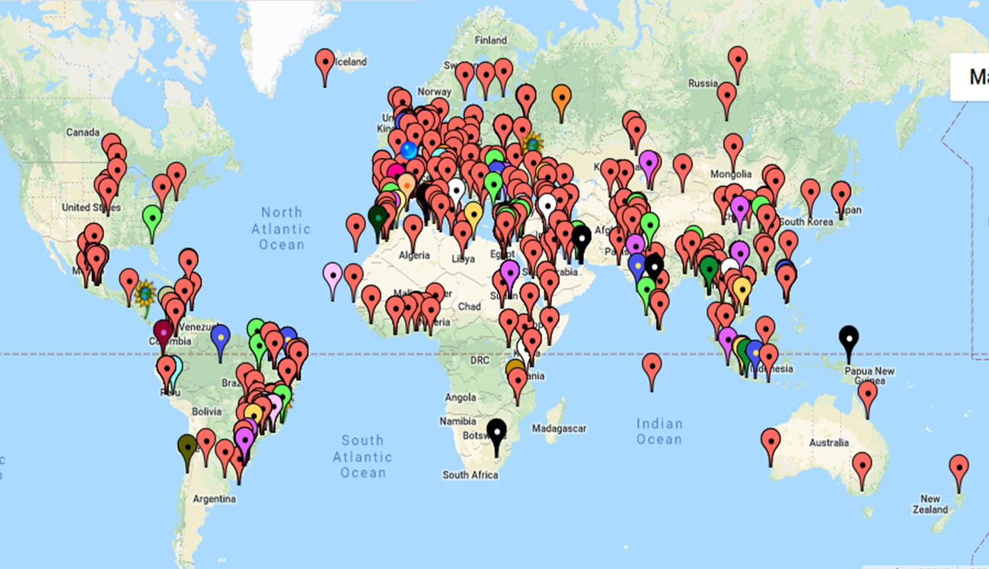
Engagement
Foster a community of practice

Slide 10
Engagement
Be an active member of that community
Make use of learners’ locations or local situations
Be ready for lurkers and for silence

Slide 11
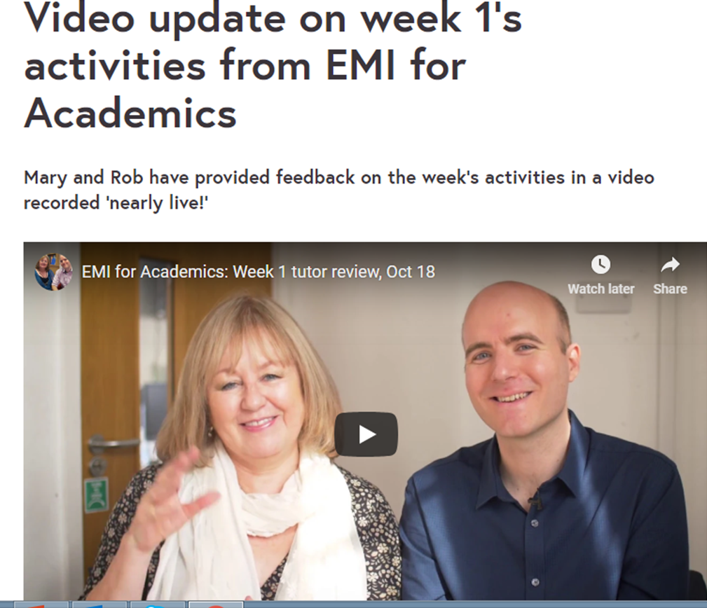
Teaching/tutoring
Teacher/ facilitator / guide / learner
Clear instructions and structure
Mix of high profile and low key activities

Slide 12
Closing remarks
Be empathic – if you find online learning distracting, intense, lonely, enjoyable, challenging, addictive, tiring…then so will your students!
Enjoy the challenge – getting it right is very rewarding

Slide 13
Questions?
Thank you for listening!
UoS MOOCs https://www.southampton.ac.uk/courses/free-online-learning.page

