Slide 1

Web Whatsapp
A brief guide
Designed by Gabriel Cardoso

Slide 2
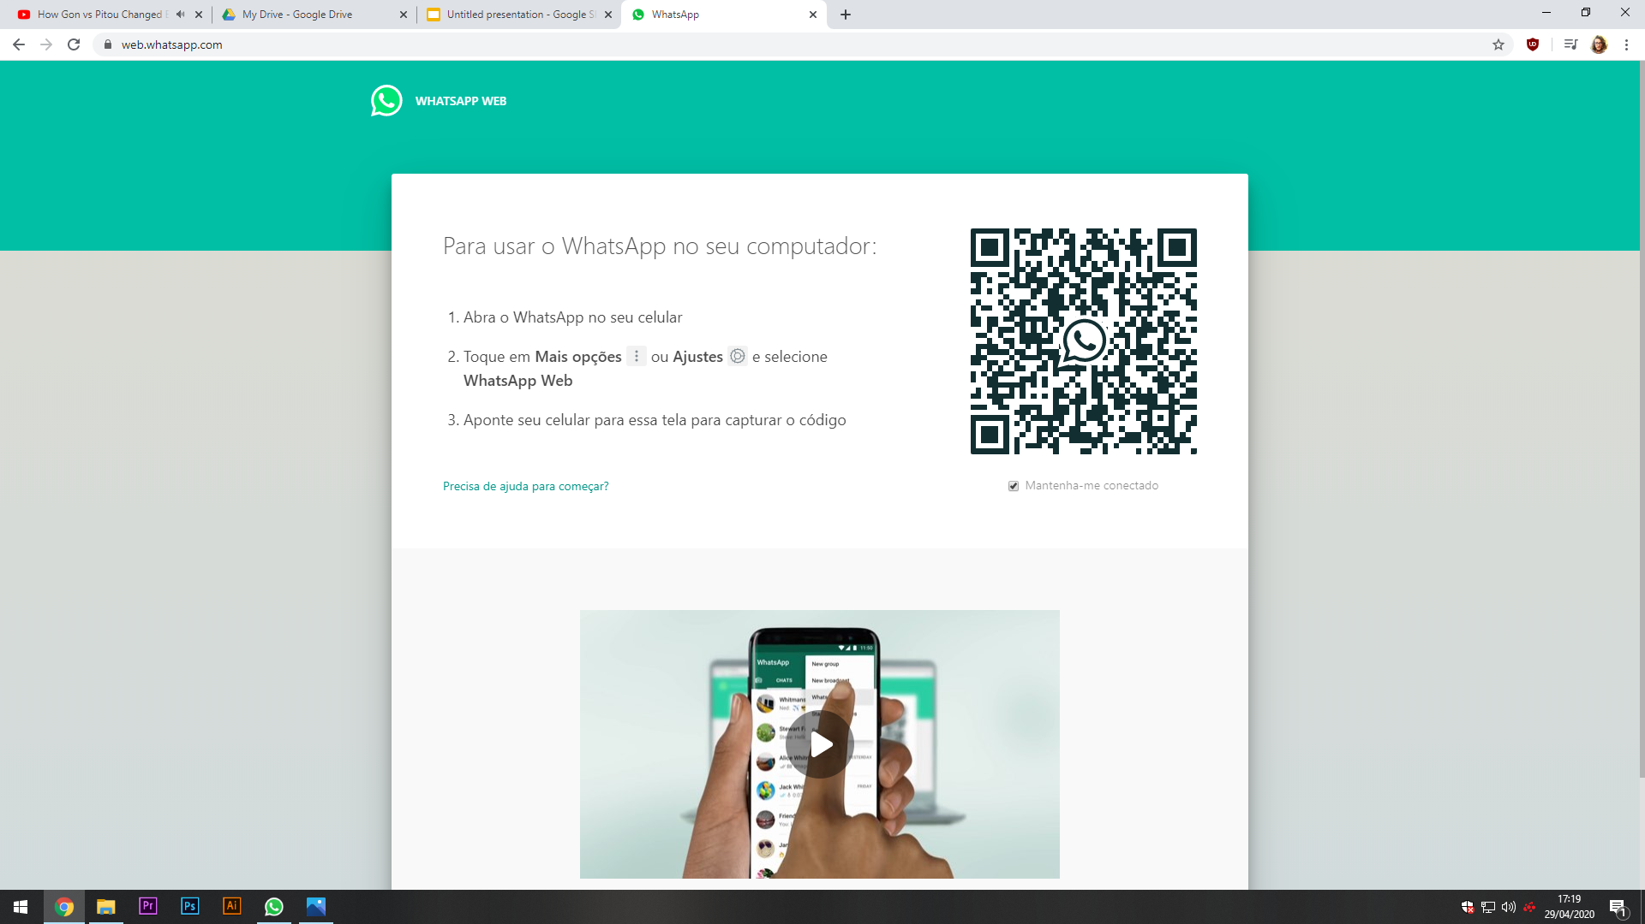
Step 1
Go to
https://web.whatsapp.com/
on your computer.
Designed by Gabriel Cardoso

Slide 3
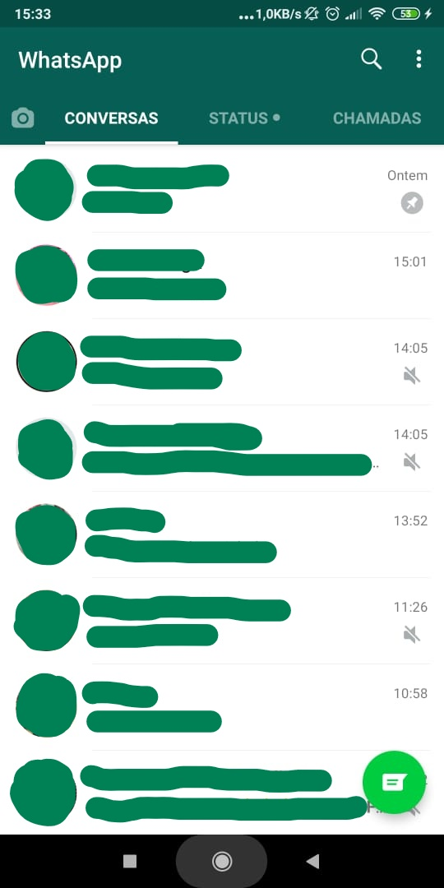
Step 2
Open the app on your phone
Designed by Gabriel Cardoso

Slide 4
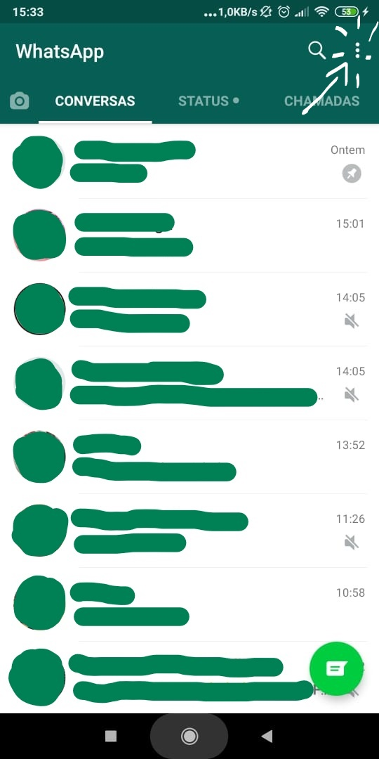
Step 3
Click on this icon.
Designed by Gabriel Cardoso

Slide 5
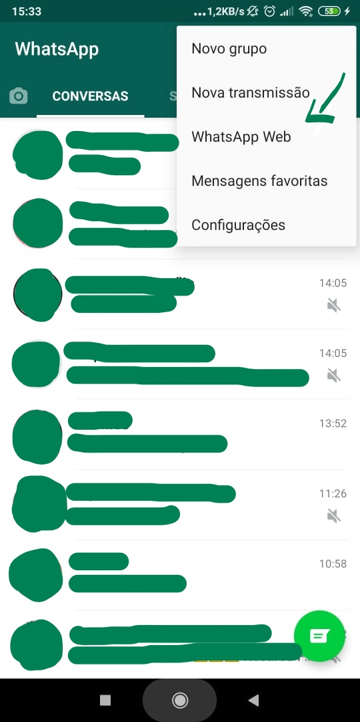
Step 4
You’ll find the option “Whatsapp Web”.
Click on it
Designed by Gabriel Cardoso

Slide 6
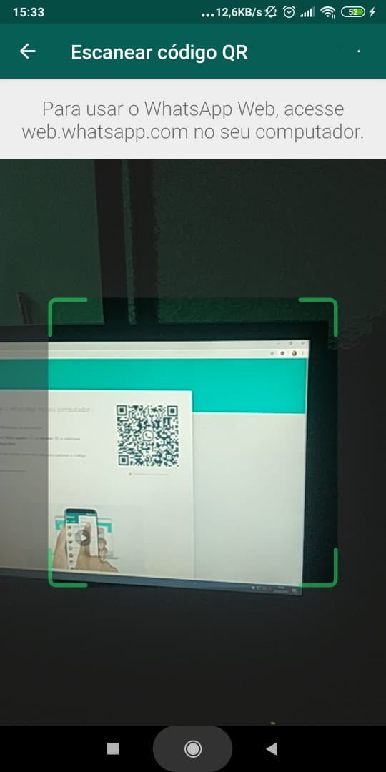
Step 5
Now point your camera to the QR code on the screen of your computer.
And...
P.S: The app will need to access your phone’s camera at this point, you just have to authorize.
Designed by Gabriel Cardoso

Slide 7
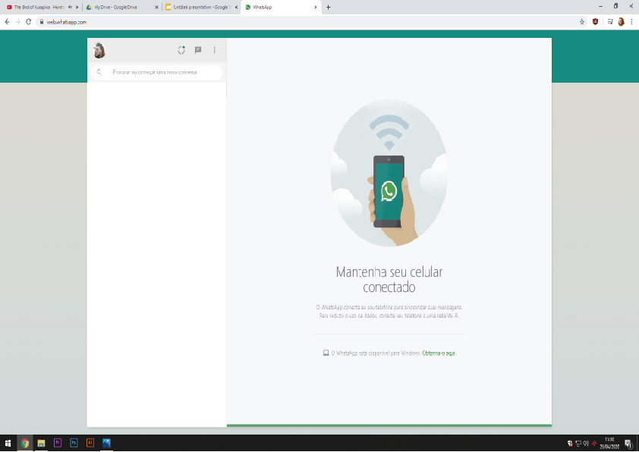
You’re in!
Now all you gotta do is look for me in your contact list, and write me your amazing journals.
Designed by Gabriel Cardoso

Slide 8


*you texting me journals*
*me receiving them*
Designed by Gabriel Cardoso

Slide 9
Hope this helps.
If you need anything, just let me know.
Email me at gabrielcardoso55@hotmail.com
or
text me (31) 99372-3439
My metaphorical door is always open.
Can’t wait to read your journals!
Designed by Gabriel Cardoso

