Slide 1
Teaching English online
John Schulz J.B.Schulz@soton.ac.uk
Karla de Lima Guedes K.K.De-Lima-Guedes@soton.ac.uk

Slide 2




In this session…
How to build rapport when teaching online
Ideas for breakout rooms
Developing speaking skills online
Assessing language skills online
Time management in remote teaching
Homework ideas

Slide 3
Before we start... a poll.
How confident do you feel about teaching online?
www.wooclap.com/UOS
Notes:
https://app.wooclap.com/events/OHMDGA/questions/5ec2780ec3ab865e204f81c3

Slide 4
How to build rapport when teaching online
Allow
time for chitchat / to connect with students
Arrange
sessions in smaller groups.
Be
animated
Get
to know your students
Create
a sense of presence
Turn
the camera on

Slide 5

Rapport is all about making the online environment personable
Emails become my first contact with students
  Email before course starts
  Announcements
  Lots of private emails
    Thank you
    Asking if they understood everything
Videos
  Short ad-hoc catch-up videos (ephemeral videos)
    Informal and need to include you in the video
Webinars
  Eye contact - position of camera is important
    (ipads, phones and laptops are not always the best camera location.
  Use names
  Ask students to present visual elements // and to personalise ideas

Slide 6

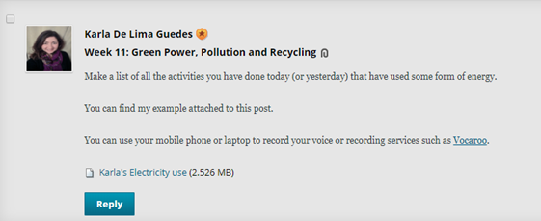
Developing speaking skills online
live/recorded presentations (Flipgrid)
breakout rooms
recorded responses (Vocaroo or Voicethread), e.g. add story to a picture
Notes:
https://youglish.com/pronounce/water/english/uk?

Slide 7
Developing speaking skills online
live/recorded presentations (Flipgrid)
breakout rooms
recorded responses (Vocaroo or Voicethread), e.g. add story to a picture
(a)synchronous group work (portfolio?)
give students different roles to play in the synchronous sessions
use real life tasks
pronunciation exercises followed up by recordings (Lingt) or analyse pronunciation (and its variations) in context (Youglish)
Notes:
https://youglish.com/pronounce/water/english/uk?

Slide 8
Ideas for breakout rooms
Project-based activities
Give students a task/goal → Share with group
Create a visual → Share with group
Joint writing (Wiki)
Preparation for a debate
    (could the BO rooms be available in advance for groups)
Role plays (mock interviews)
Games (any small group collaborative activity)

Slide 9
Win as Much as You can
(Example game)
Group 1
Group 2
Group 3
Main Room
Group 4
Group 5
https://www.trainingcoursematerial.com/free-games-activities/conflict-resolution-influencing-and-negotiation-activities/win-as-much-as-you-can

Slide 10
Assessing language skills online
Writing
Joint writing – focus on the process and product (Google Drive)
Discussion Forums
Reading
Listening
Online tests/ proctoring/ Live play (Watch2gether)
Note-taking followed up by questions/ discussion
Online tests/ proctoring
Grammar
Grammar exercises (Lingoset)
Note-taking followed up by questions/ discussion
Speaking
Live/recorded presentations or interactions (Vocaroo)
Recorded pronunciation/ Q&A (Lingt)
Combine skills
Read and report a piece of news (orally or written)
Notes:
Watch2gether https://w2g.tv/whdldoboemznyw3uuh

Slide 11
Time management in remote teaching
Webinars, Live lectures
Plan everything in advance
  Send out agenda /questions
  Segment to keep engagement (3 x 20 minute sections)
Maybe link to asynchronous activities
  Pre-allocate people to answer.
  Have a sign-up sheet
Presentations
  Be reasonable for time allocation
  (Hour = 6 x 10minutes)

Slide 12
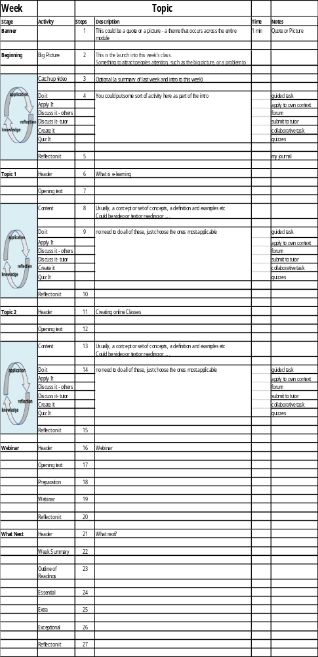
Time management in remote teaching
Lesson Plans are critical.
How long will each part take (be realistic)
Reading takes far longer than you imagine

Slide 13

Homework ideas
Research to present in synchronous lesson
Take part in a discussion forum
Read on a topic to discuss in synchronous lesson and/or share a new vocab/expression
Watch a video/ listen to a recording, make notes, discuss questions in synchronous lesson
Contribute to a padlet wall
Think about what you might give f2f students, how would this work in an online environment
Are there new things that you can do, now that you are online.
https://c2jhrk2l.optimalworkshop.com/optimalsort/33584cjn-1

Slide 14
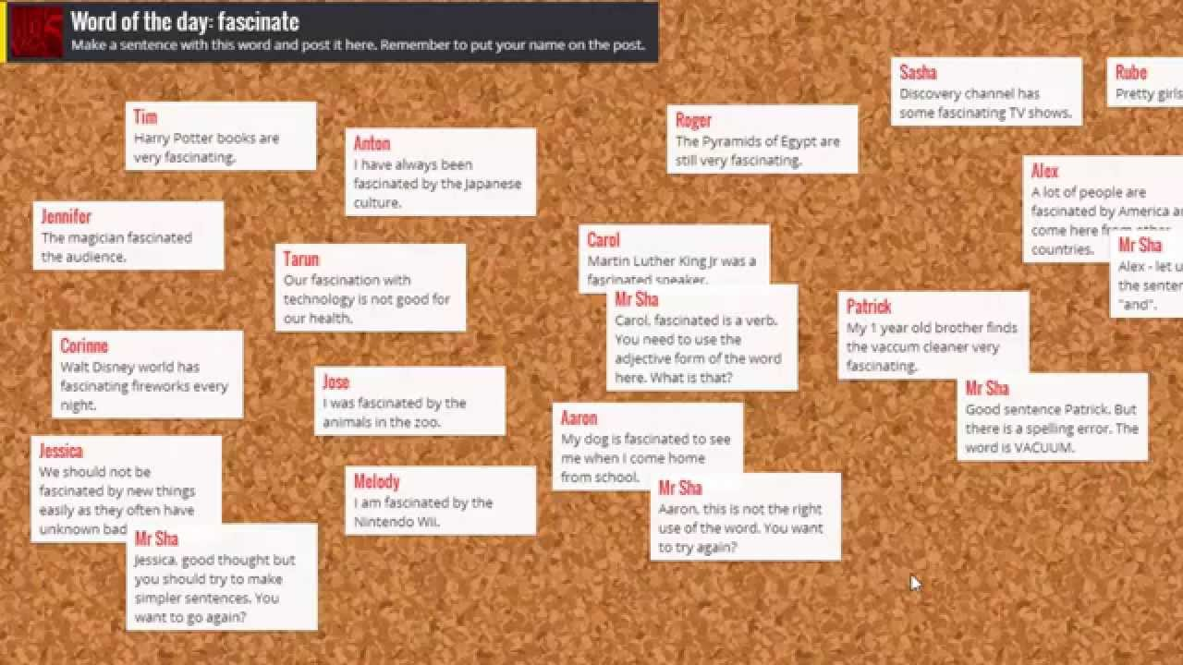

Notes:
Vocabulary, Q&A, Storyline,

Slide 15
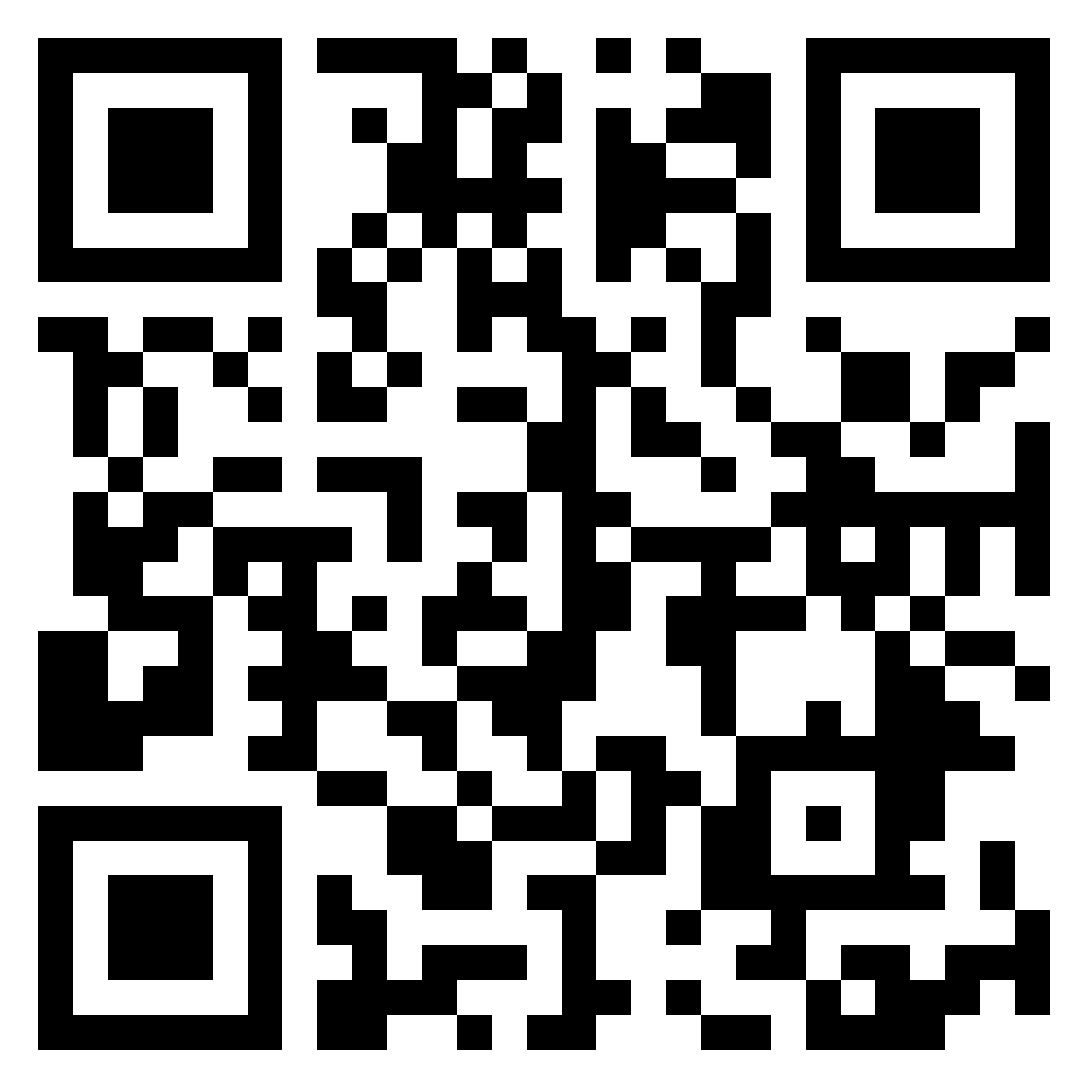
What am I likely to do/use from today's session?
https://padlet.com/kdelimaguedes/mdc0isv0b3jw1pr9

