Slide 1
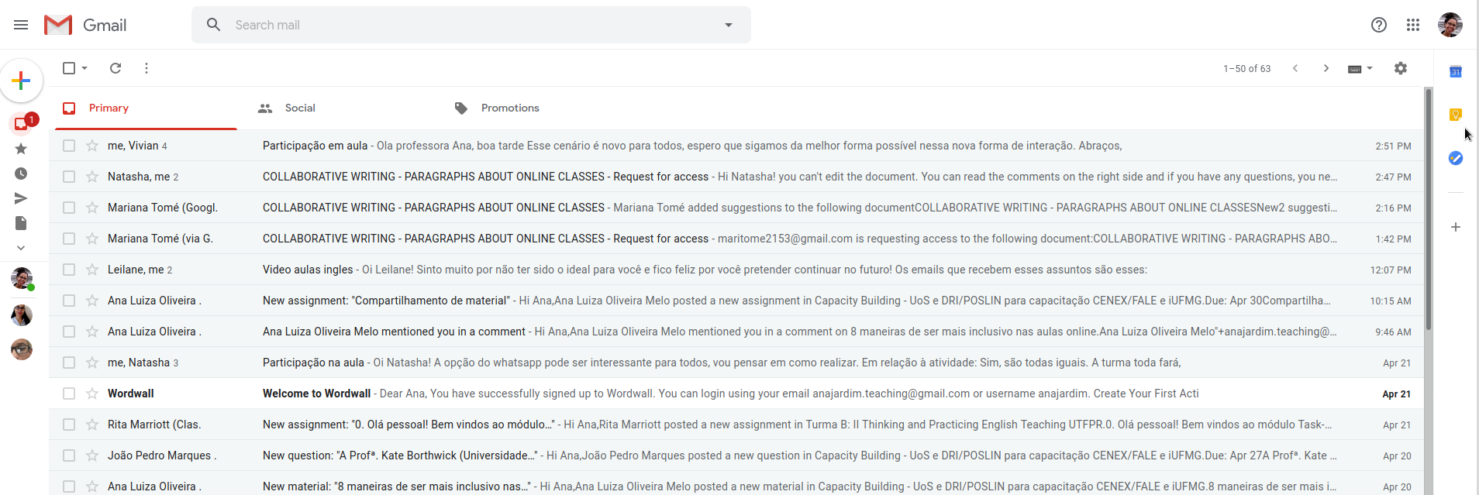
Sign in to your Gmail account. Click on the dots on the right side of the page.

Slide 2
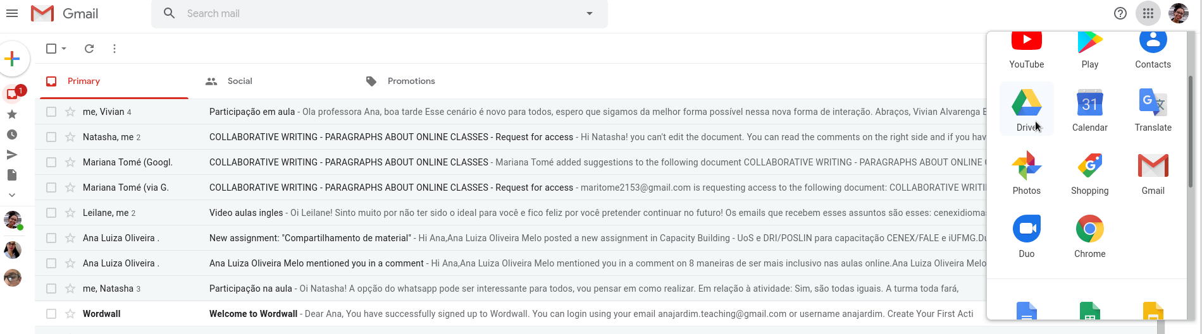
Select Drive’s icon

Slide 3
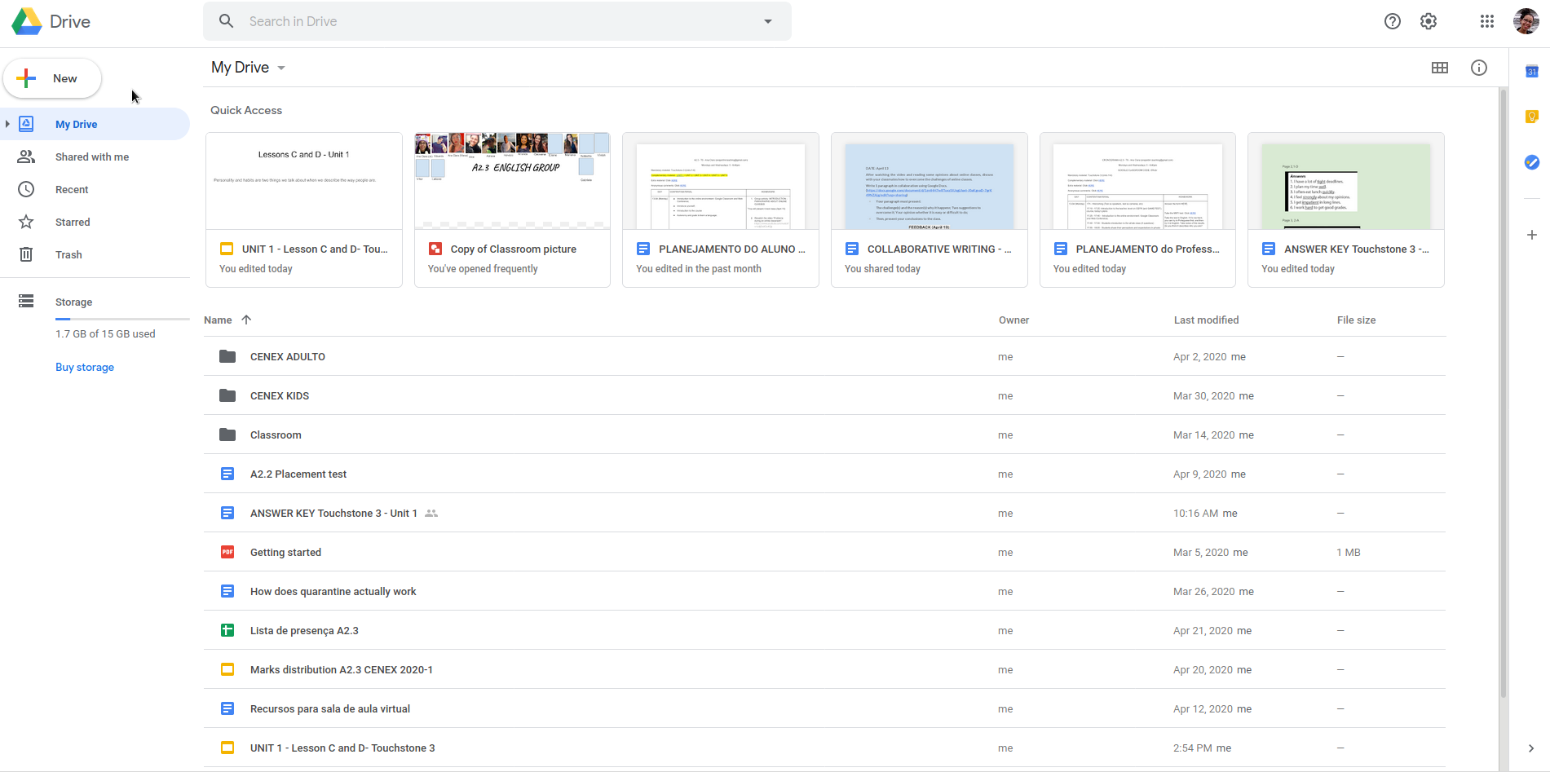
This is the main page. You’ll see your files.
Click on “New” on the left side.

Slide 4
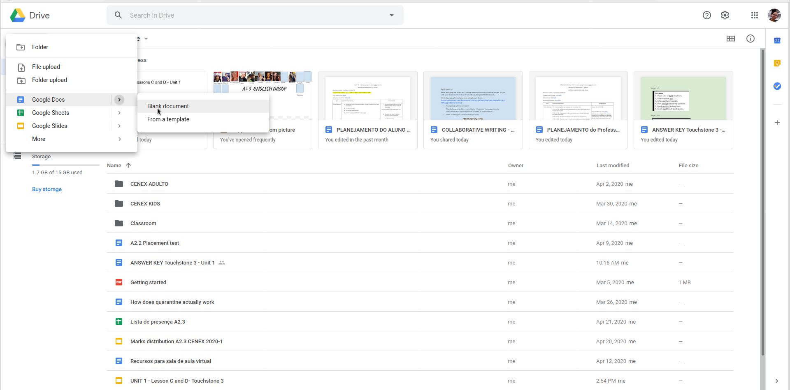
Click on “Google Docs” >>> “Blank document”

Slide 5
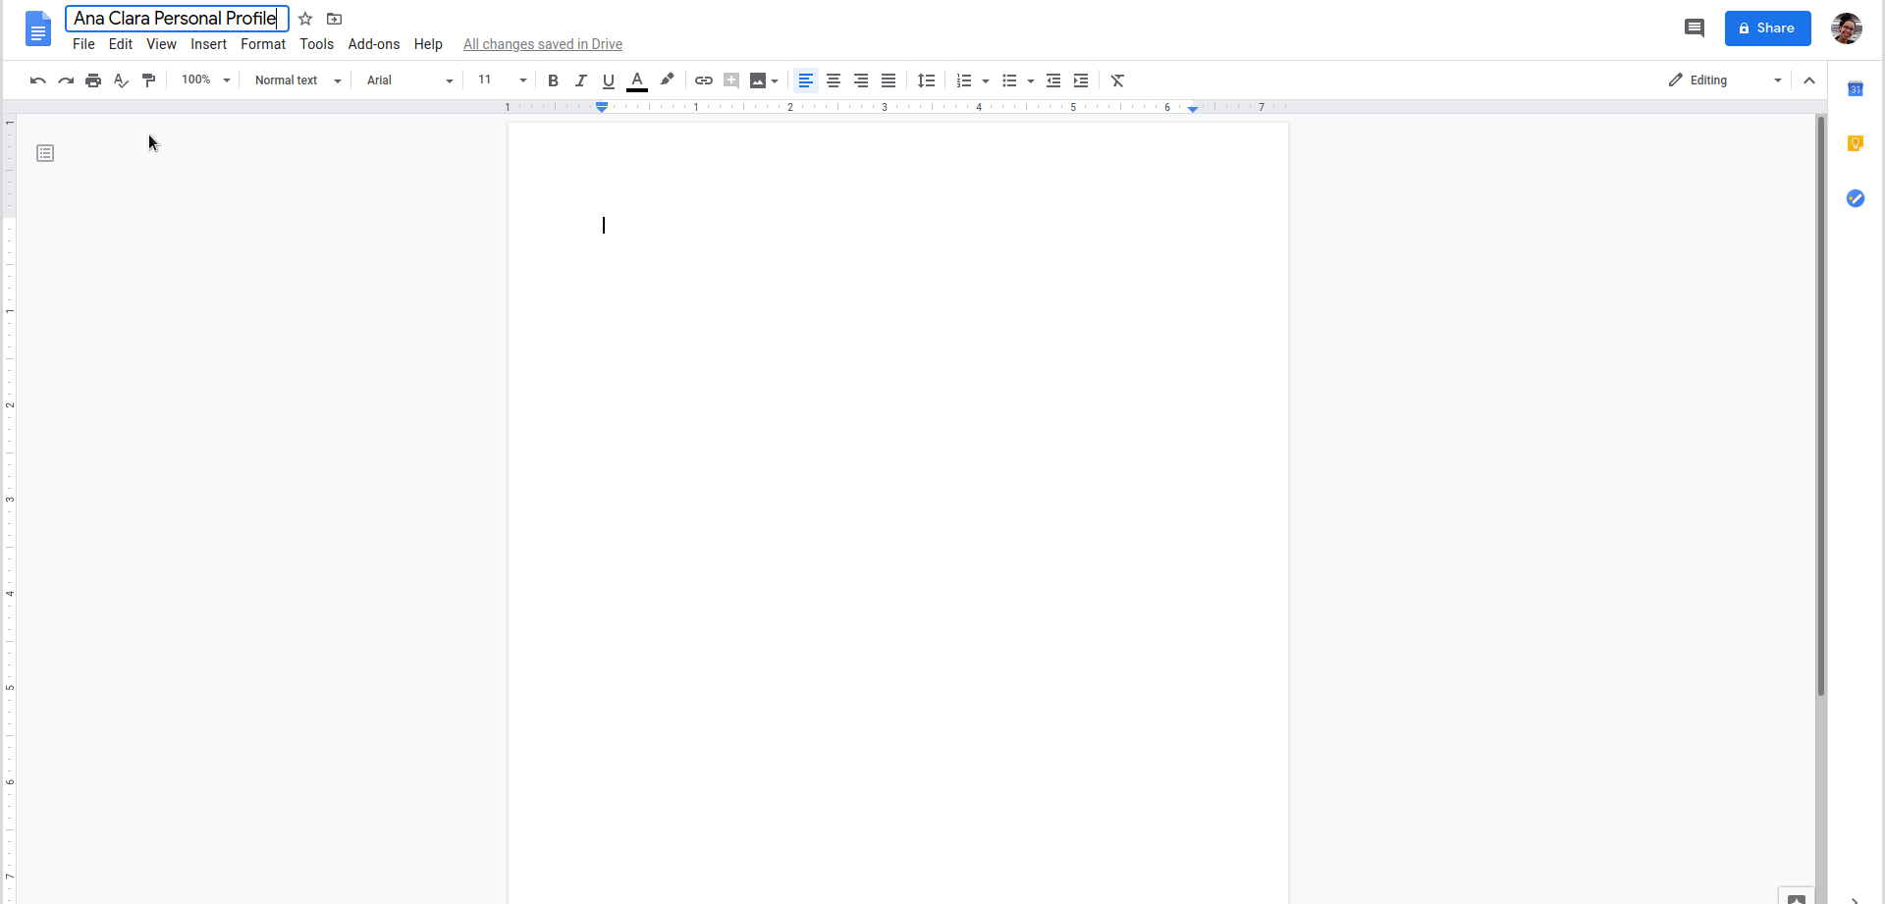
You created the doc! Now, edit the title (click on it)!

Slide 6
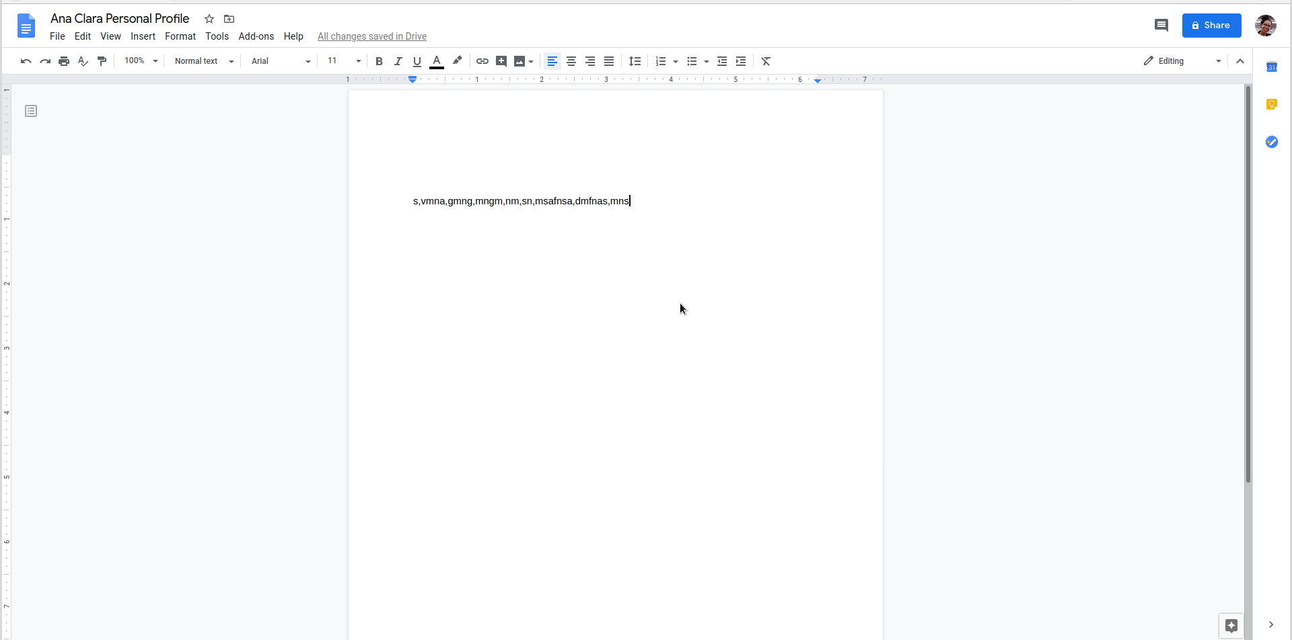
Now you can type your text and edit it the way you like.
edit
type

Slide 7
When you finish your text, share it with your teacher. Click on “share” on the right side.

Slide 8
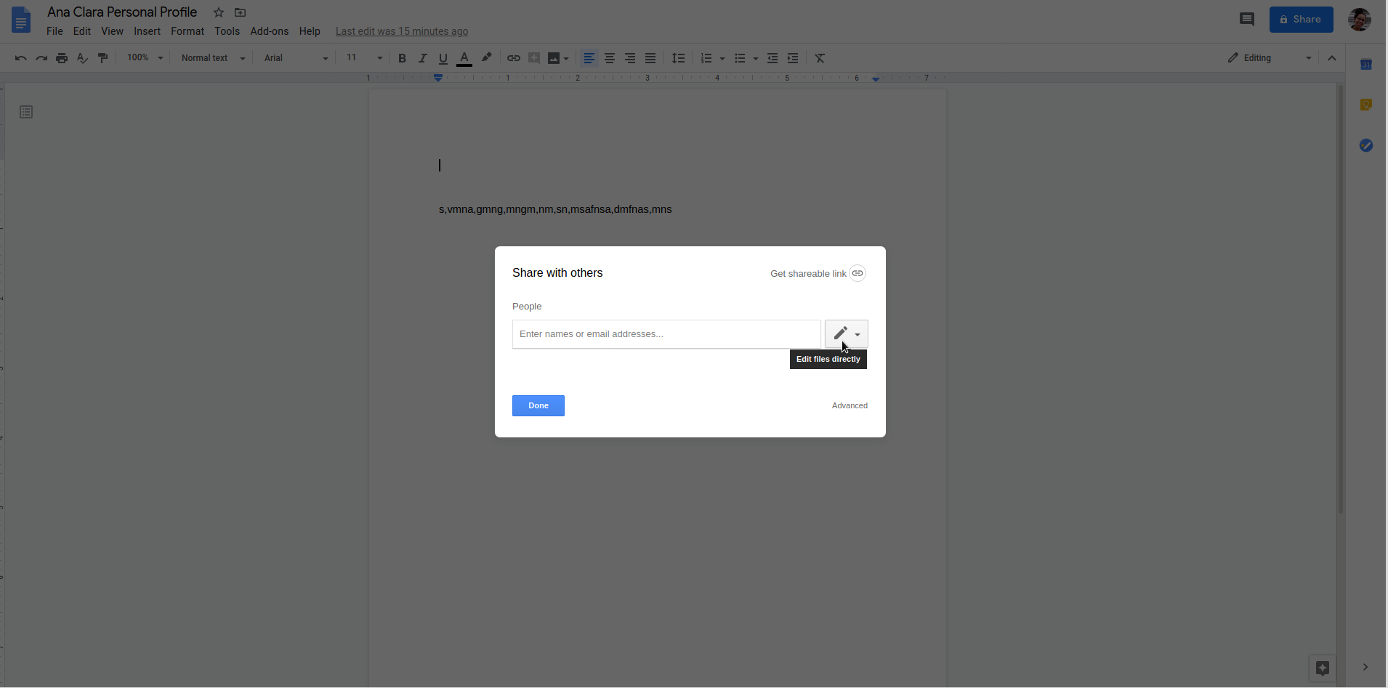
Select this icon (the pencil). It means the teacher will be able to edit the document.

Slide 9
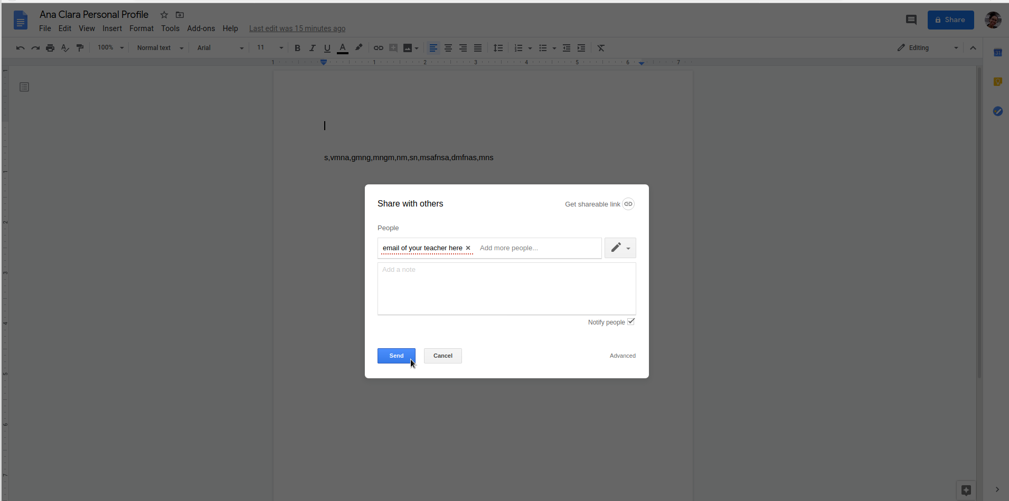
Type the email of your teacher on the box and click on “Send”.

